Slide 1
HEART STROKE DETECTION
SDG 3 : GOOD HEALTH AND WELL - BEING
KEERTHANA -RA2211003011028
GOWTHAM-RA2211003011029
LIKHITH REDDY-RA2211003011030

Slide 2
INTRODUCTION
Heart stroke is a serious medical condition that occurs when blood flow to the brain is interrupted, leading to potential brain damage or even death. Early detection of stroke risk factors can significantly improve patient outcomes by enabling timely medical interventions.
Machine learning (ML) has emerged as a powerful tool in healthcare, allowing for the analysis of large datasets to identify patterns and predict potential health risks. By using ML algorithms, we can develop predictive models that assess the likelihood of a stroke based on various risk factors such as age, hypertension, diabetes, smoking habits, and cholesterol levels.
This study aims to build an ML-based stroke detection system that utilizes classification algorithms such as Logistic Regression, Decision Trees, Random Forest, and Support Vector Machines (SVM). The goal is to improve the accuracy of stroke prediction, aiding healthcare professionals in early diagnosis and prevention strategies.

Slide 3
DATA SCIENCE INVOLVED
1. Problem Definition
Define the objective: Predict whether a person is at risk of a stroke based on medical and lifestyle factors.
2. Data Collection
. The dataset may include features like age, gender, hypertension, heart disease, smoking status, BMI, and glucose levels.
3. Data Preprocessing
Handling Missing Values: Fill missing values using mean/median imputation or remove incomplete records.
Data Cleaning: Remove duplicate or inconsistent entries.
. Feature Scaling: Normalize or standardize numerical data to improve model performance.
4. Exploratory Data Analysis (EDA)
Statistical Summary: Check distributions, mean, median, and standard deviation of features.
Data Visualization: Use histograms, box plots, and correlation heatmaps to understand feature relationships.

Slide 4
DATA SCIENCE INVOLVED
5. Feature Selection & Engineering
Select important features using correlation analysis, feature importance scores, or dimensionality reduction (PCA).
Create new meaningful features if needed (e.g., combining BMI and age to create a new risk factor).
6. Model Selection & Training
Choose ML classification models such as:
Logistic Regression
Decision Trees
Random Forest
Support Vector Machine (SVM)
Gradient Boosting (XGBoost, LightGBM, CatBoost)

Slide 5
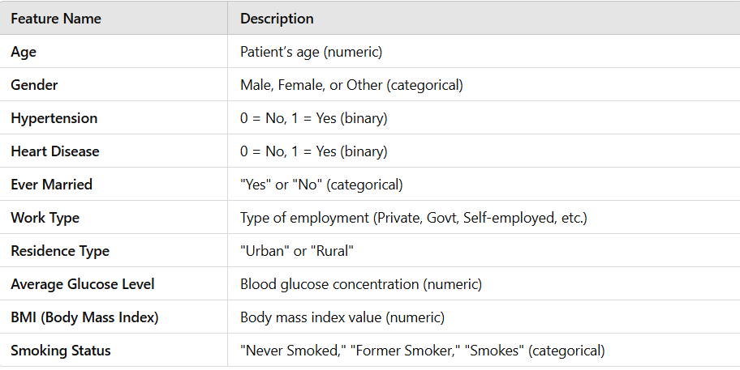
INPUT ATTRIBUTES (Features)

Slide 6
OUTPUT ATTRIBUTES (Predictions & Actions)
1. Binary Classification Output
Stroke (Primary Output):
0 = No Stroke
1 = Stroke
2. Probability Scores
Stroke Risk Probability:
A score between 0 and 1, indicating the likelihood of having a stroke.
Example: 0.85 (85% risk), 0.20 (20% risk)
3. Stroke Severity Prediction
If stroke is detected, estimate the severity based on clinical risk factors:
Mild Stroke
Moderate Stroke
Severe Stroke

Slide 7
OUTPUT ATTRIBUTES (Predictions & Actions)
4. Risk Factor Contribution (Feature Importance as Output)
Instead of just predicting stroke risk, the model can provide explanations for why a person is at risk.
Example:
"High blood glucose and hypertension contribute 70% to stroke risk."
"Smoking increases your stroke risk by 40%."
5. Survival Prediction (Post-Stroke Mortality Risk)
If stroke is detected, estimate the chance of survival based on historical patient data.
Example Output:
80% chance of recovery
20% mortality risk
6. Timeframe for Stroke Risk
Instead of a static stroke prediction, the model can estimate when a stroke is likely to happen:
Short-term risk (within 1 year)
Medium-term risk (1–5 years)
Long-term risk (5+ years)

Slide 8
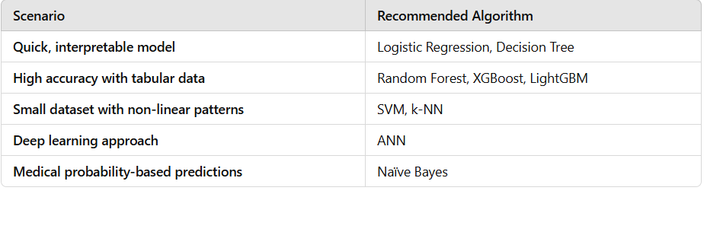
MACHINE LEARNING ALGORITHM USED

Slide 9
CONCLUSION
Heart stroke is a critical medical condition that requires early detection for effective prevention and treatment. Machine learning (ML) provides a powerful approach to predicting stroke risk by analyzing patient data, identifying key risk factors, and improving diagnostic accuracy.
By applying various ML algorithms such as Logistic Regression, Random Forest, XGBoost, and Artificial Neural Networks (ANN), we can develop predictive models that assist healthcare professionals in making informed decisions. Feature engineering, proper data preprocessing, and model evaluation using metrics like accuracy, precision, recall, and F1-score are essential to ensure reliable predictions.
Implementing ML-based stroke detection systems can help in early diagnosis, personalized treatment plans, and reducing mortality rates. However, continuous model improvement and real-world validation with clinical data are necessary for ensuring effectiveness in healthcare applications.

Slide 10
THANK YOU

